Slide 1

Analyzing Twitter Sentiment for Stock Market Research Internship Report
Narendra Kumar Vasa
LCI20201032
Under the Supervision of Dr. Abhinesh kaushik
Notes:
Welcome!
Today, our group wants to present “Title”
This will be interesting so don’t lose focus!

Slide 2

Introduction and Background
Predicting stock prices is challenging due to various factors influencing market movements.
Social media, particularly Twitter, provides real-time insights into public sentiment, impacting investor behaviour and stock prices.
Traditional models rely on historical data and economic indicators for stock predictions.
Rise of social media introduces new data sources for market analysis.
Objective
Develop predictive models using Twitter sentiment analysis for stock market predictions.
Comparing the Models and finding the best analysis performing model
Notes:
So as you might already know from our title, core message that we are trying to deliver is Blah Blah
Any Why Twitter? Blah Blah.
For example, a couple of months ago, Elon Musk tweeted and said Blah…
This was when Tesla stock was $781.88 and TSLA stock fell 4.46% as a result of this tweet.
So now you know how Twitter sentiment can affect the price of various stocks. Let us explain what kind of data and models that we used.

Slide 3

MOTIVATION
Real-Time insights:
Twitter provides real-time insights into public sentiment, allowing investors to quickly gauge market mood.
Investors and analysts can react promptly to changing sentiments, potentially gaining a market edge.
Traditional models mainly rely on historical data and economic indicators; integrating sentiment data provides a more comprehensive analysis.
Combining sentiment analysis with historical data improves the accuracy of stock price predictions.
Demonstrates the significant impact of public sentiment and emotions on market behaviour.
Merges traditional financial indicators with modern social media data for better market understanding.

Slide 4
Literature Review:
(Based on Integrating Social Media Sentiment with Stock Market Prediction)
The influence of public sentiment on stock market movements has been extensively studied, with significant findings. Bolen et al. (2011) and Zhang et al. (2011) demonstrated that sentiment from Twitter could predict the Dow Jones Industrial Average (DJIA) and enhance stock market trend predictions. These studies highlight the potential of social media sentiment as a leading indicator of market movements.
Sentiment analysis, or opinion mining, uses natural language processing (NLP) to determine sentiment in text. Techniques range from lexicon-based approaches, like those by Pang and Lee (2008), to advanced machine learning models. While lexicon-based methods can miss language nuances, machine learning techniques, including convolutional neural networks (CNNs) and recurrent neural networks (RNNs), have shown improved performance in capturing sentiment, as demonstrated by Pak and Paroubek (2010), and Giachanou and Crestani (2016).
Machine learning algorithms, such as random forests and gradient boosting, are widely applied in financial forecasting due to their ability to model complex relationships. Random forests, introduced by Breiman (2001), and used effectively by Hsu et al. (2016), handle high-dimensional data well. XGBoost, by Chen and Guestrin (2016), and LSTM networks, shown by Fischer and Krauss (2018) to capture temporal dependencies, are also effective in predicting stock returns. Studies by Oliveira et al. (2017) and Xu and Keelj (2018) further show the benefits of combining sentiment analysis with machine learning for stock prediction.

Slide 5





Data & Models
Twitter Data: Data from Kaggle (https://www.kaggle.com/nadun94/twitter-sentiments-aapl-stock)
Stock Data: Stock Price of Apple from Yahoo Finance from Jan 01, 2016 to Aug 31, 2019.
Machine Learning Models: LSTM, Random Forest, XG Boost and Gradient Boost to fit the data, make predictions and compare performance between models.
Data Visualization: hvPlot and Matplotlib.
Notes:
This includes ts_polarity and twitter_volume, date starting from January 01, 2016 to August 31, 2019

Slide 6

Methodology
Comprehensive Approach to Predict Stock Price Trends:
Feature Engineering:
Sentiment Analysis of Tweets includes calculation polarity scores using TextBlob, with scores ranging from -1 (very negative) to +1 (very positive).
Aggregating Daily Sentiment Scores Summarized daily sentiment by averaging polarity scores for each trading day.
Combining Twitter and Stock Data Merges daily sentiment scores and tweet volumes with historical stock data. Used adjusted closing prices as the target variable for predictions.
Developed features representing previous days' stock prices to capture temporal dependencies.
Especially for classification approach Converted adjusted closing prices into binary labels (1 for price increase, 0 for price decrease).

Slide 7
2) Model Training and Evaluation:
Regression
Classification
Methodology
A rolling windows-based regression method was used on adjusted closing prices for Apple stock.
The 3 previous day prices were used as features and the 4th day price as the target vector.
Twitter polarity scores and volume were also used as features.
Methodology
The adjusted closing price for Apple stock was converted into binary form based on the difference in current price vs previous day price.
This was done to analyze the trend in the market with a rise represented as 1 and a fall in price represented as 0.
Twitter polarity scores were used to classify tweets into positive, negative and neutral sentiments. Binary encoding of these sentiments was used to run the classifier models.
Models
LSTM RNN
Random Forest Regressor
XG Boost Regressor
Models
Random Forest Classifier
Gradient Booster

Slide 8
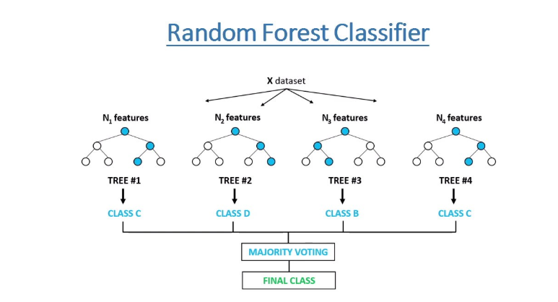
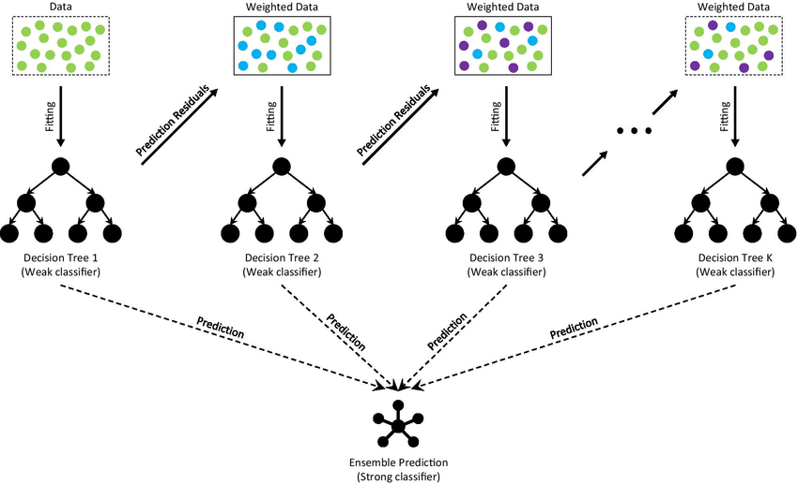
Classification Approach:
a)Random forest classifier:
The Random Forest Classifier is an ensemble learning method that constructs multiple decision trees during training and outputs the class that is the mode of the classes predicted by individual trees. The model is trained using features derived from Twitter sentiment (daily sentiment score and tweet volume) and the binary trend label (0 for price decrease, 1 for price increase).
b) Gradient Boosting Classifier:
Gradient Boosting Classifier builds an ensemble of trees sequentially, where each new tree focuses on correcting errors made by the previous ones. The model uses the features and binary trend labels, adjusting weights iteratively to minimize the classification error.

Slide 9
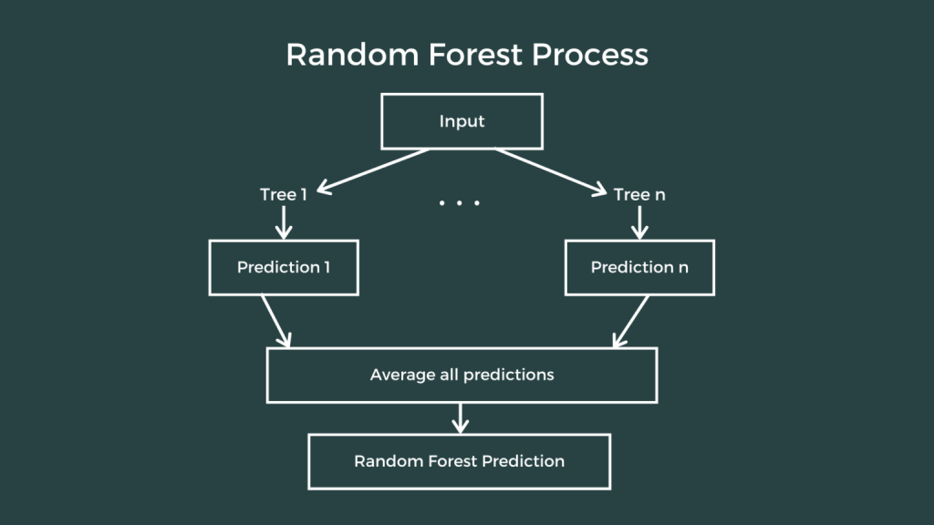
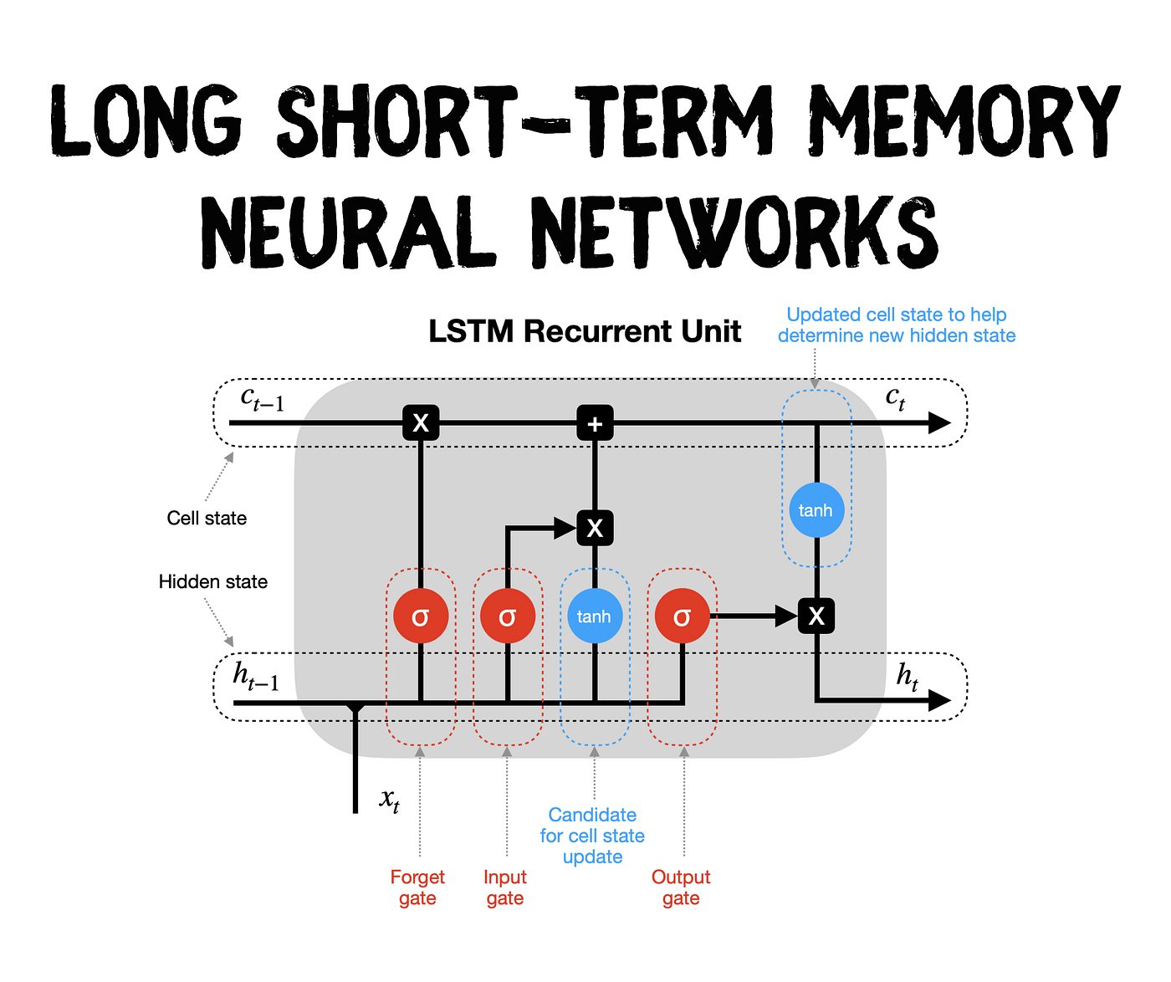
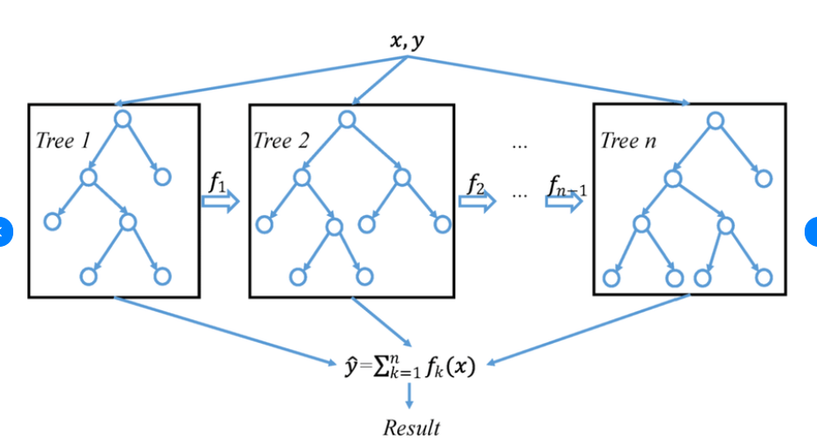
Regression Approach
Random Forest Regressor:
The Random Forest Regressor uses an ensemble of decision trees to predict a continuous target variable, averaging the predictions of individual trees. The model is trained using historical adjusted closing prices and Twitter sentiment features
b) LSTM RNN (Long Short-Term Memory Recurrent Neural Network):
LSTM networks are specialized for capturing long-term dependencies in time-series data. They consist of memory cells that maintain information for long periods. The model is trained on sequences of historical adjusted closing prices and sentiment features.
b) XGboost regressor:
XGBoost is an optimized gradient boosting algorithm that builds sequential trees, where each tree aims to correct errors made by previous trees. The model is trained using the same features as the other regressors, focusing on minimizing the objective function.

Slide 10
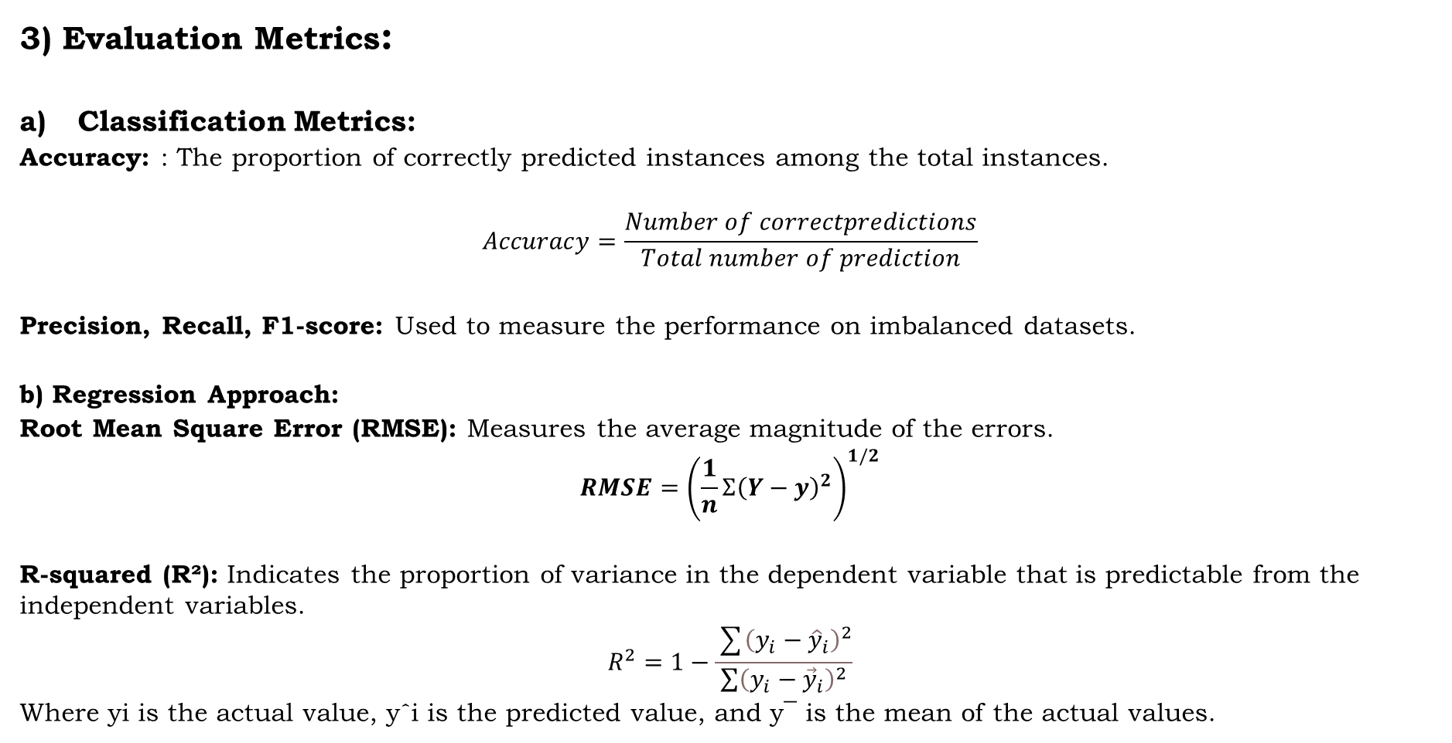
3) Evaluation Metrics:
Classification Metrics:
Accuracy: : The proportion of correctly predicted instances among the total instances.
$$Accuracy=\frac{Number of correctpredictions}{Total number of prediction}$$
Precision, Recall, F1-score: Used to measure the performance on imbalanced datasets.
b) Regression Approach:
Root Mean Square Error (RMSE): Measures the average magnitude of the errors.
$$RMSE={\left(\frac{1}{n}Σ{\left(Y−y\right)}^{2}\right)}^{1/2}$$
R-squared (R²): Indicates the proportion of variance in the dependent variable that is predictable from the independent variables.
$$R^{2}=1−\frac{\sum{{\left(y_{i}−{\hat{y}}_{i}\right)}^{2}}}{\sum{{\left(y_{i}−{\vec{y}}_{i}\right)}^{2}}}$$
Where yi is the actual value, yˆi is the predicted value, and y¯ is the mean of the actual values.

Slide 11
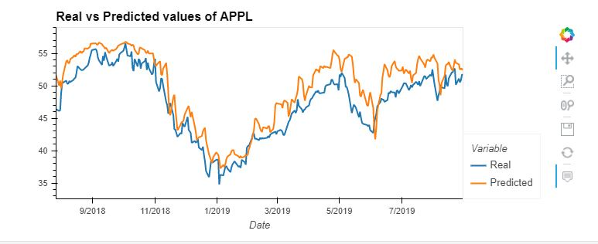
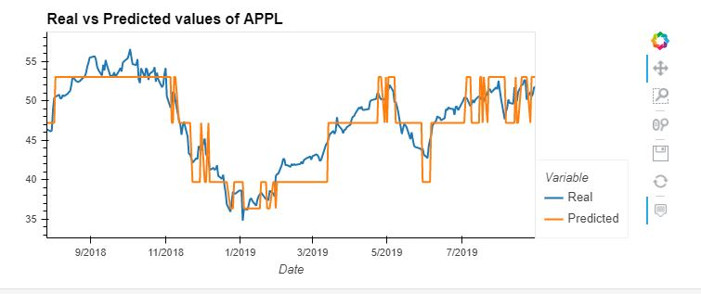
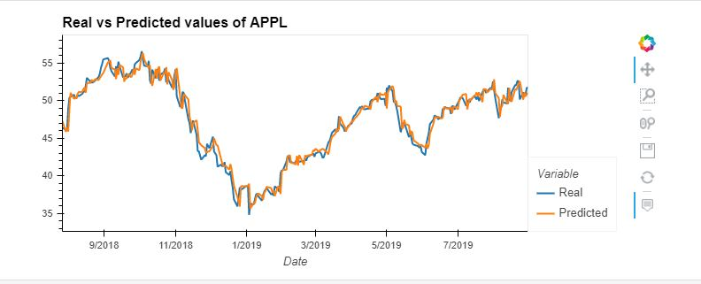
Results <Regression Approach>
LSTM
R-Squared : 68.01%
RMSE : 0.1334
LSTM
Random Forest Regressor
XG Boost
RF Regressor
R-Squared : 82.27%
RMSE : 0.0993
XG Boost
R-Squared : 95.92%
RMSE : 0.0477

Slide 12
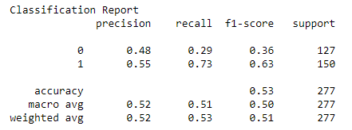
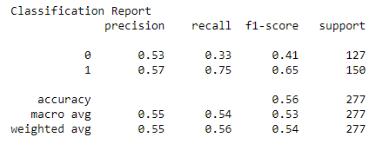
Results <Classification Approach>
RF Classifier
Random Forest Classifier
Gradient Booster
Gradient Booster

Slide 13
Limitations during data preparation and model training
Data Availability Challenges:
High Noise-to-Signal Ratio: Social media data, especially from Twitter, contains a lot of noise which can affect the reliability of sentiment analysis.
API Limitations: Twitter API restrictions can limit the amount of data that can be collected and analysed, potentially biasing the dataset.
Historical Data Gaps: Incomplete or inconsistent historical stock data and tweet data alignment may impact the accuracy of the predictions.
Sentiment analysis Challenges:
Context and Nuance: Simple lexicon-based sentiment analysis methods may miss the context and subtle nuances in language, such as sarcasm or slang.
Model Complexity and Performance:
Overfitting: Complex models like LSTM and XGBoost are prone to overfitting, especially with a high-dimensional dataset, potentially reducing their generalizability.

Slide 14
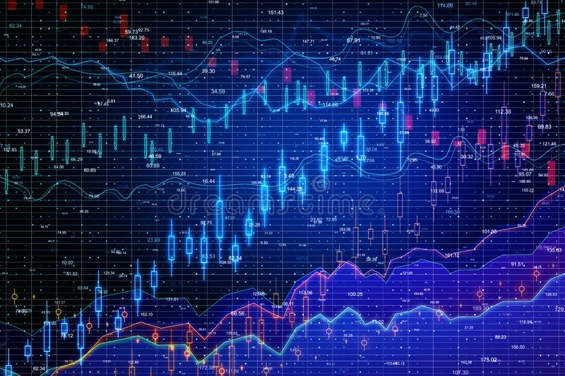
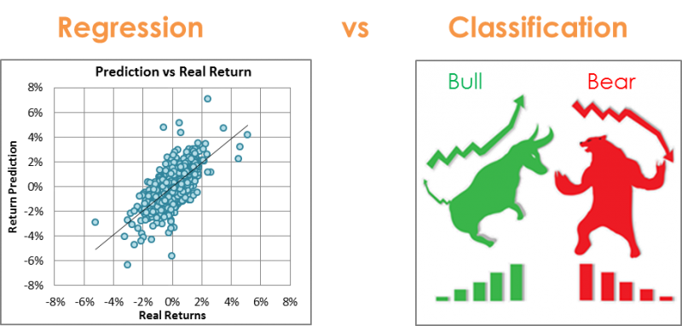
Conclusion
The regression approach turned out to be a better approach for predicting apple stock price as opposed to the classification approach.
This project shows that there is evidence of dependence between stock price and twitter sentiment.
However, this needs to be further investigated to accurately forecast a connection between social media and market behavior.
Through this research the final outcome is regression approach is better for estimating stock market trends in that XGboosting performs better than other regression models.

Slide 15

Future Work:
Develop and incorporate more sophisticated natural language processing models that can better understand context, sarcasm, and evolving language on social media.
Implement context-aware sentiment analysis methods to improve the accuracy of sentiment detection, especially for financial jargon and company-specific events.
Extend data collection to include other social media platforms like Facebook, Reddit, and financial news forums to capture a broader spectrum of public sentiment.
Apply advanced data cleaning and noise reduction techniques to filter out irrelevant or misleading information from social media data.
Improve methods for aligning social media data with financial market events and trading days to ensure accurate temporal synchronization.

Slide 16
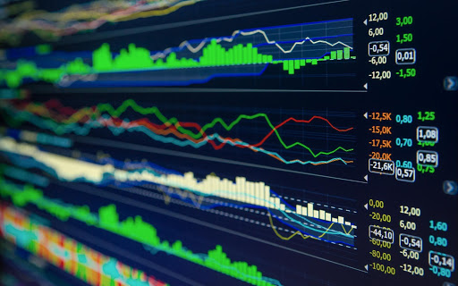
References
[1] J. Bolen, H. Mao, and X. Zeng, “Twitter mood predicts the stock market,” Journal of Computational Science, vol. 2(1), no. 11, pp. 1– 8, 2011.
[2] X. Zhang, H. Fuehres, and P. A. Gloor, “Predicting stock market indicators through twitter ”i hope it is not as bad as I fear”,” Procedia Social and Behavioural Sciences, vol. 26, pp. 55–62, 2011.
[3] B. Pang and L. Lee, “Opinion mining and sentiment analysis,” Foundations and Trends® in Information Retrieval, vol. 2(1-2), pp. 1–135, 2008.
[4] A. Pak and P. Paroubek, “Twitter as a corpus for sentiment analysis and opinion mining,” In LREc (Vol. 10, No. 2010), 2010.
[5] A. Giachanou and F. Crestani, “Like it or not: A survey of twitter sentiment analysis methods,” ACM Computing Surveys (CSUR), 49(2), 1-41., 2016.
[6] L. Breiman, “random forests,” Machine Learning, 45(1), 5-32, 2001.
[7] S.-H. Hsu, S. Lessmann, M.-C. Sung, T.-S. Ma, and J. E. Johnson, “Bridging the divide in financial market forecasting: machine learners vs. financial economists,” Expert Systems with Applications, 61, 215- 234, 2016.
[8] T. Chen and C. Guestrin, “Xgboost: A scalable tree boosting system,” In Proceedings of the 22nd ACM SIGKDD International Conference on Knowledge Discovery and Data Mining (pp. 785-794), 2016.
[9] T. Fischer and C. Krauss, “Deep learning with long short-term memory networks for financial market predictions,” European Journal of Operational Research, 270(2), 654-669, 2018.
[10] N. Oliveira, P. Cortez, and N. Areal, “The impact of microblogging data for stock market prediction: Using twitter to predict returns, volatility, trading volume and survey sentiment indices,” Expert Systems with Applications, 73, 125-144, 2017.
[11] Y. Xu and J. Keelj, “Stock price prediction using deep learning models.” arXiv preprint arXiv:1810.09936., 2018.

Slide 17



Thank You

